Slide 1


TECHVERSE
TechVerse
Name :- Kevin A. Chaudhari
Roll No. :- CE012
Group:- 08
Mentor :- ABS

Slide 2


Introduction
Cross-platform educational mobile application Multi-role system (Student, Teacher, Admin) Premium content model with payment integration Real-time query system for student-teacher interaction Firebase-powered backend with cloud storage

Slide 3
Problems being Solved
Limited Access to Quality Education: Students struggle to find comprehensive educational content
Fragmented Learning Experience: No unified platform for PDFs, videos, and interactive learning
Lack of Direct Teacher Interaction: Students need immediate help but lack direct communication channels
Monetization Challenges for Educators: Teachers need sustainable ways to earn from their content
Problem Statement and
Motivation
Why This App is Needed
Centralized Learning Hub: All educational content in one place
Freemium Model: Free PDFs, premium videos for sustainable monetization
Real-time Support: Direct query system for instant teacher assistance
Cross-platform Accessibility: Works on Android, iOS, and Web

Slide 4




Create a Unified Educational Platform
Integrate PDF and video content management
Provide seamless user experience across devices
2. Implement Multi-Role Architecture
Student dashboard for content consumption
Teacher dashboard for content creation and query management
Admin dashboard for system management
Key Goals
3. Establish Sustainable Monetization
Free PDF access for all users
Premium video content with payment integration
Revenue sharing model for teachers
4. Enable Real-time Communication
Student query submission system
Teacher response mechanism
Query tracking and status management

Slide 5
Technology Stack
 | Frontend: Flutter 3.8.1 - Cross-platform UI framework Dart - Programming language Material Design - UI/UX framework Backend & Database: Firebase Authentication - User management Cloud Firestore - NoSQL database Firebase Storage - Cloudinary for PDFs/videos Payment Integration: Razorpay Flutter - Payment gateway Test Mode: ₹1 premium upgrade
 | Media & Content: Video Player - Chewie plugin for video playback File Picker - Content upload functionality URL Launcher - External PDF viewing Additional Plugins: Image Picker - Profile and content images HTTP - API communications UUID - Unique identifier generation

Slide 6

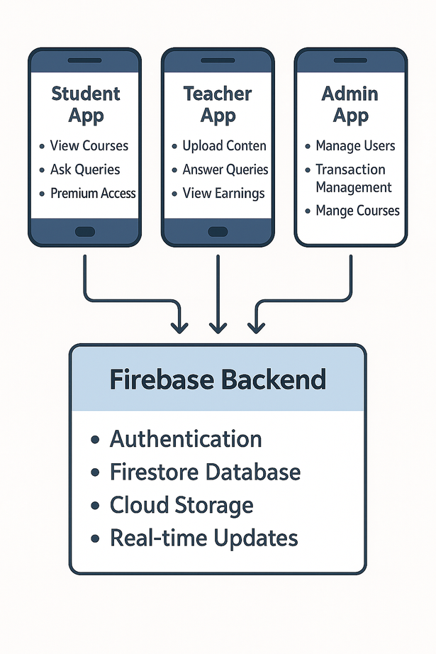
System Design
High-Level Architecture
System Design
State Management: StatefulWidget for local state management StreamBuilder for real-time data updates Firebase Streams for live data synchronization Navigation Approach: MaterialPageRoute for screen navigation Role-based routing after authentication Context-based navigation throughout the app

Slide 7
Features of the App
For Students: 📚 Course Browsing - View available courses with descriptions 📄 Free PDF Access - Download and view PDF materials 🎥 Premium Video Content - Access videos after payment ❓ Query System - Ask questions to teachers 💳 Payment Integration - Secure premium upgrade 📱 Responsive Design - Optimized for mobile and tablet For Teachers: �� Content Upload - Add PDFs and videos to courses 💰 Earnings Tracking - Monitor payment transactions ❓ Query Management - Answer student questions �� Transaction History - View payment details | For Admins: 👥 User Management - Manage students and teachers 📚 Course Management - Create and edit courses 💳 Payment Monitoring - Track all transactions ⚙️ System Configuration - Platform settings

Slide 8
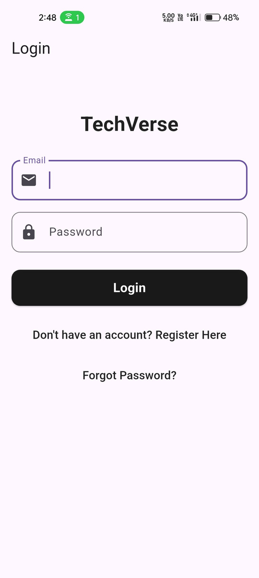
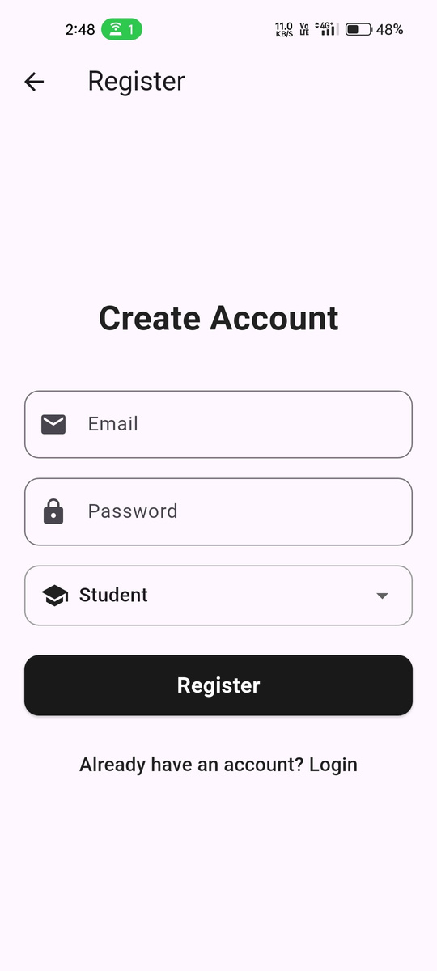
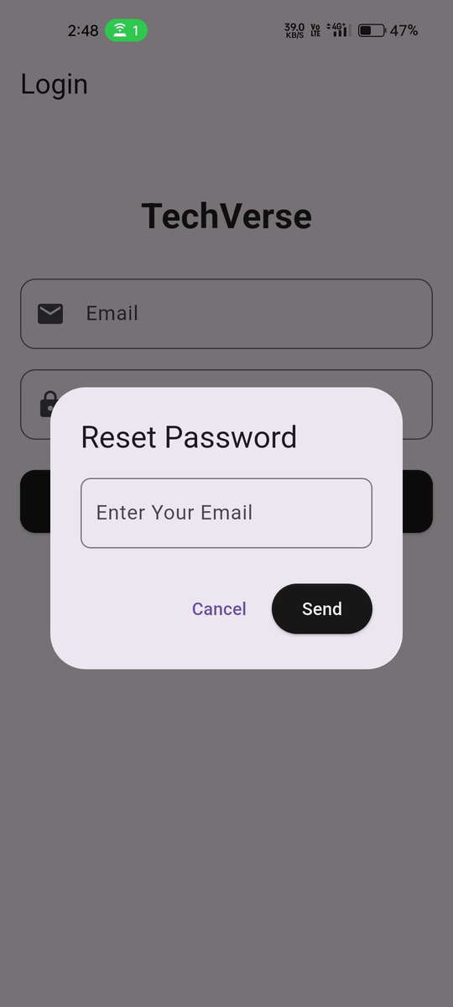
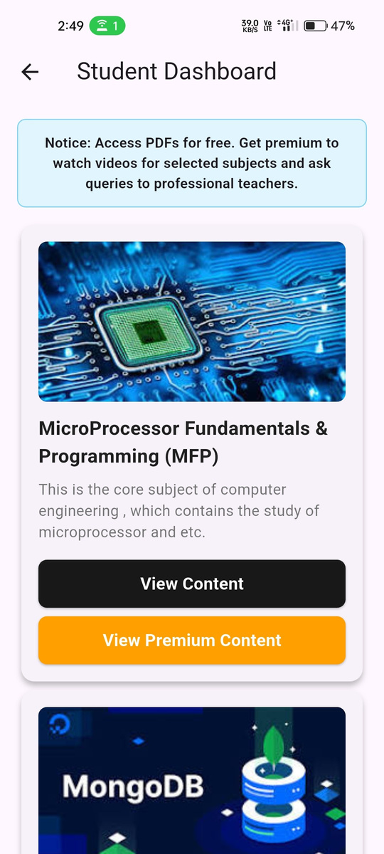
UI Screenshots

Slide 9
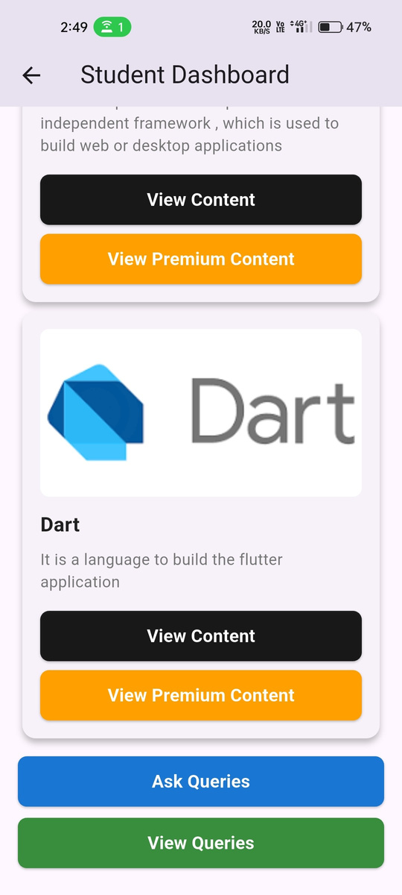




Slide 10

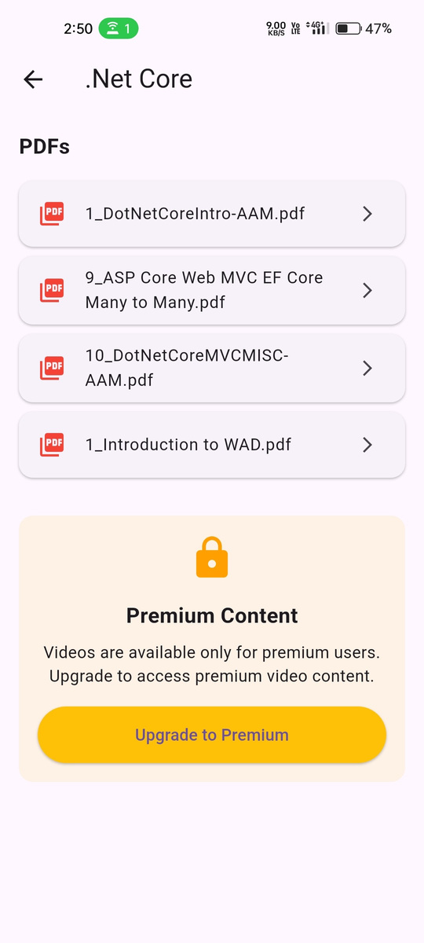
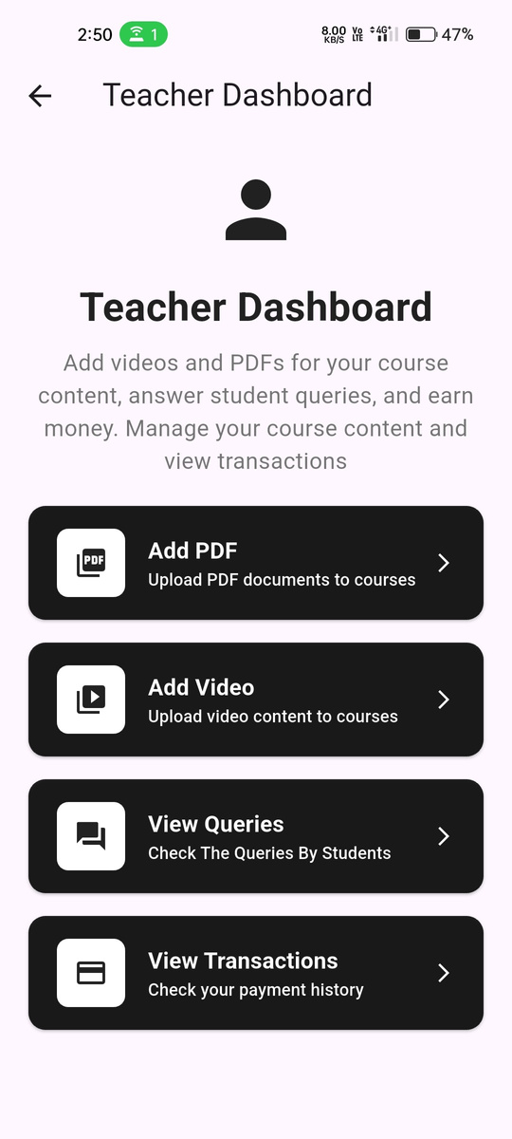


Slide 11
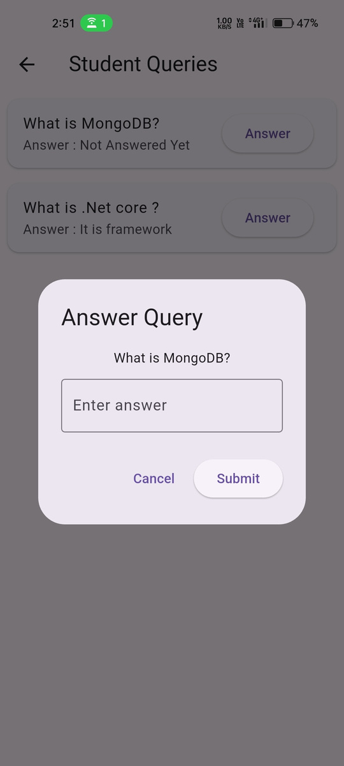


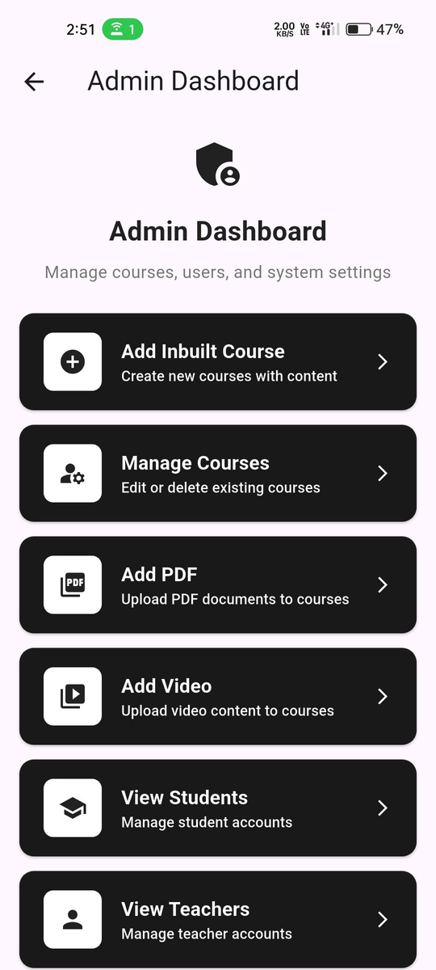

Slide 12
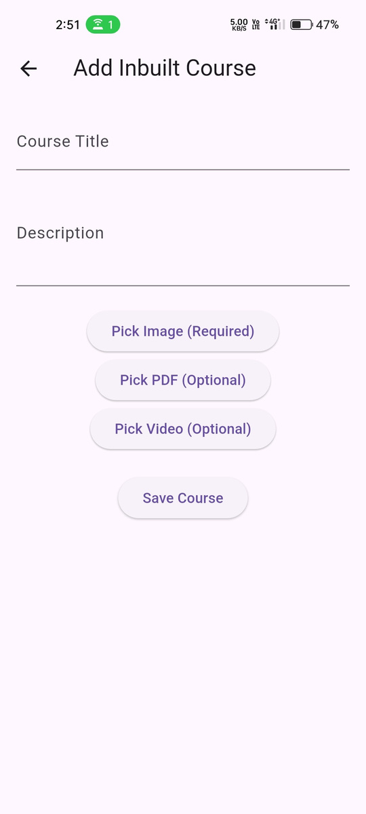
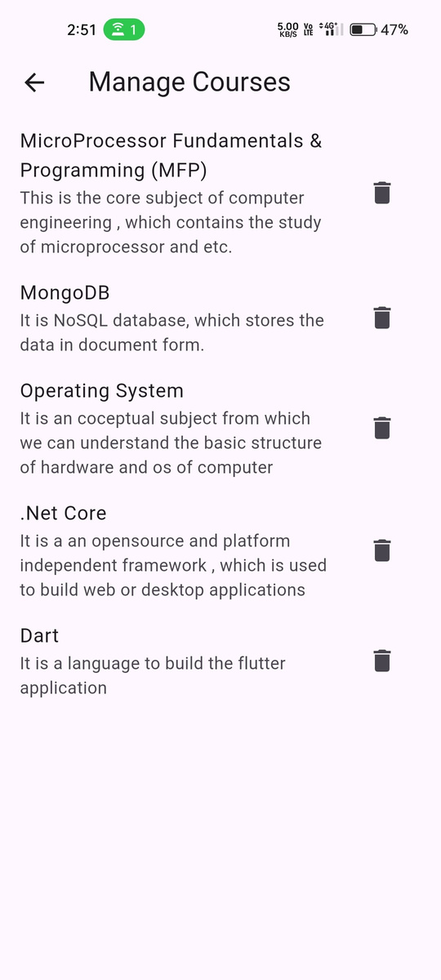
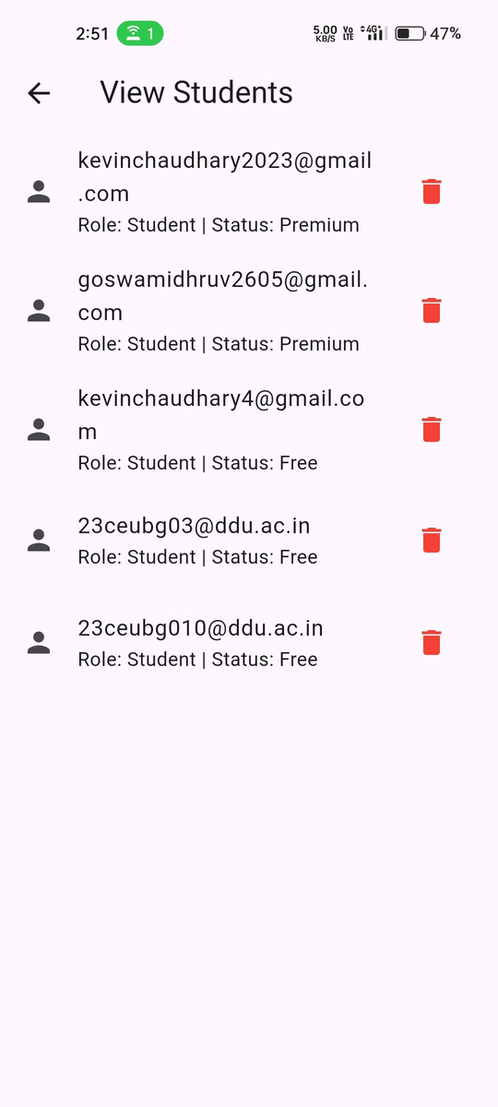
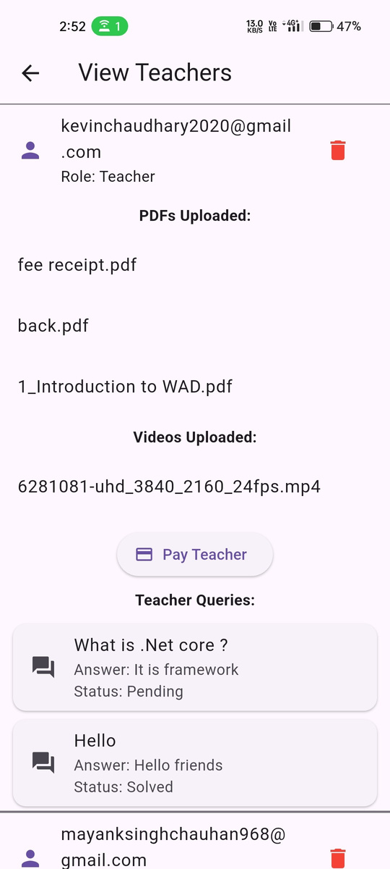
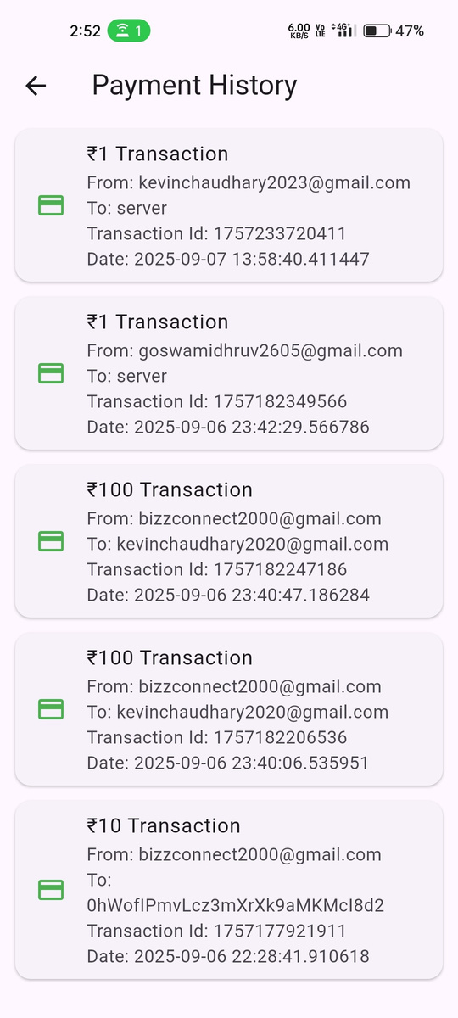

Slide 13
Implementation Details - APIs & Plugins
 | Media Management: Video Playback: Chewie plugin with custom controls PDF Viewing: URL Launcher for opening pdf in drive File Upload: Cloudinary is used to save videos and files and their url has been saved to firebase storage in document Key Dependencies: cloud_firestore: ^6.0.0 - Database firebase_auth: ^6.0.1 - Authentication razorpay_flutter: ^1.3.5 - Payments video_player: ^2.9.2 - Video playback URL Launcher - PDF viewing
 | Firebase Integration: Authentication: User registration and login management Cloud Firestore: Real-time database for courses, queries, and users Storage: Secure file upload for PDFs and videos Payment System: Razorpay Integration: Premium upgrade processing Transaction Tracking: Payment history and analytics Error Handling: Success/failure feedback mechanisms

Slide 14
Challenged Solved
df
Real-time Data Synchronization Challenge: Keeping UI updated with Firebase changes Solution: StreamBuilder with Firestore snapshots Result: Live updates across all interfaces Cross-platform Media Handling Challenge: Consistent video/PDF playback Solution: Platform-specific plugins with fallbacks Result: Seamless media experience
Role-based Navigation Challenge: Different user experiences by role Solution: Conditional navigation after authentication Result: Clean UI separation Payment Integration Challenge: Secure payment processing Solution: Razorpay with proper error handling Result: Reliable premium upgrade system

Slide 15
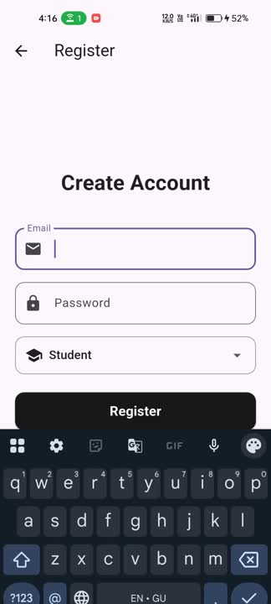

Slide 16
Results & Testing
df
Authentication System User registration with role selection Secure login with Firebase Auth Password reset functionality 2. Content Management PDF upload and viewing Video upload and playback Course creation and management 3. Payment Integration Razorpay payment processing Premium status updates Transaction tracking
4. Query System Student query submission Teacher response mechanism Query status tracking 5. Performance Outcomes: Fast loading with optimized Firebase queries Smooth UI with 60fps animations Reliable file upload/download Real-time data synchronization

Slide 17
Limitations & Future Scope
df
Current Limitations: Limited payment methods (Razorpay only) Basic query system (no real-time chat) English-only interface No offline support Basic analytics Short-term Improvements (3 months): Push notifications for query alerts Real-time chat system Search functionality Analytics dashboard
3. Long-term Vision (6-12 months): Multi-language support Offline mode with content download AI-powered query responses Certification system Multiple payment gateways Advanced learning analytics

Slide 18
Conclusion
df
Project Summary: TechVerse Flutter delivers a comprehensive educational platform addressing key online learning challenges with a sustainable monetization model.
Key Achievements: Cross-platform development with single codebase Scalable Firebase-powered architecture User-centric design for all roles Working payment integration Real-time data synchronization
Impact & Learning: Advanced Flutter development skills Full-stack mobile application experience Role-based design implementation Business model understanding
Future Vision: Becoming a leading educational platform providing quality content while empowering educators to monetize their expertise.

Slide 19

Thank You!!

